Slide 1
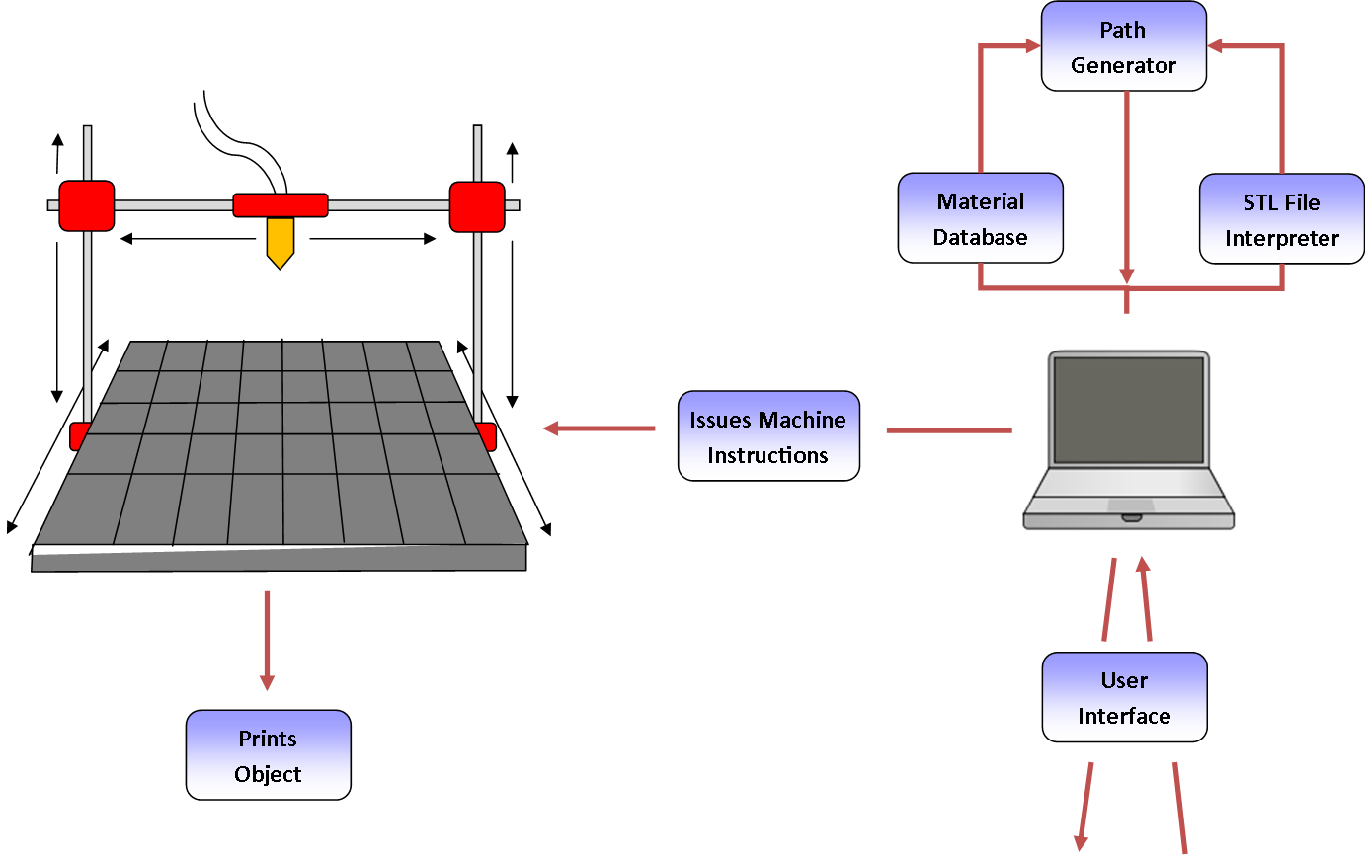
Product Concept

Slide 2
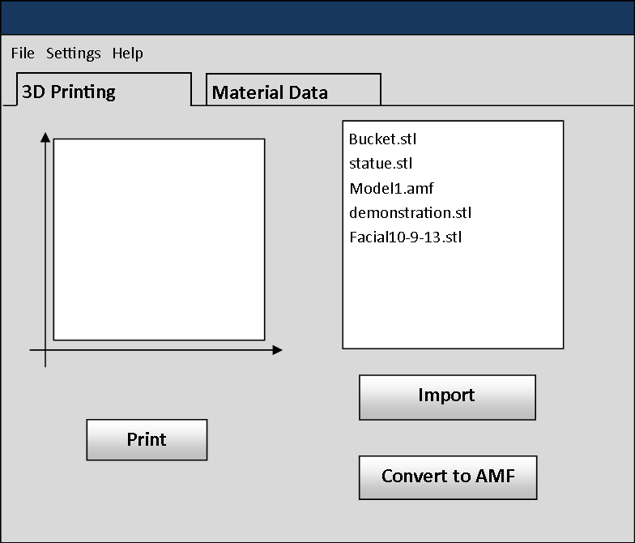
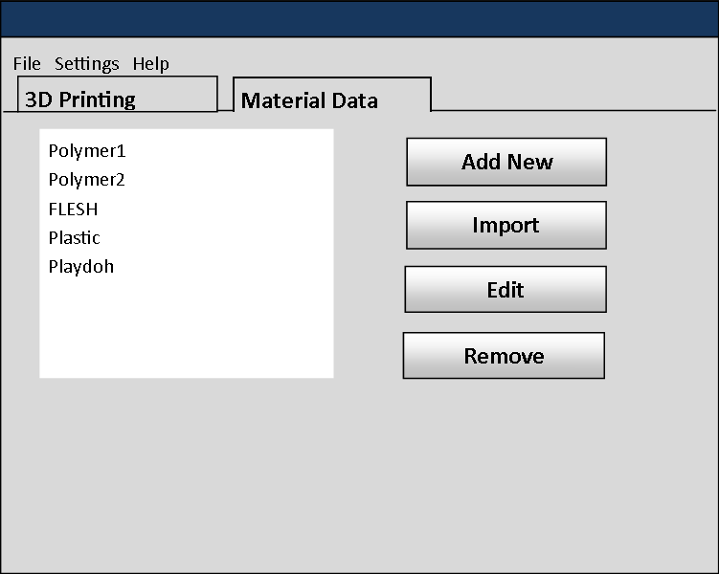
User Interface

Slide 3
Inputs and Outputs
Type: | Name: | Description: | Use:
Input: | STL File | A file format used to store data about a 3D model. | The system will process this file to determine what the shape of the object we are printing is.
 | Material Data | Contains information necessary for printing with each material such as extrusion speed, temperature it should extrude at, and speed at which the nozzle can move while extruding. | The system stores this information in a small database and retrieves the info when it is ready to use that material. The material data is imperative for printing that material properly.
 | Selection | All the settings and options that must be defined before the printing can be done (e.g. material type, how many objects will be printed at once) | The system at minimum will require a user to select an STL file of an object the user wants printed.
 | Start Printing | An interface option to begin printing. | The user presses this button after initializing what will be printed and the correct parameters for the material being used are in place.
 | Stop/Pause Printing | An interface option to end or pause printing after printing has started. | An option to halt printing can be useful in case of errors that are occurring that are not being caught by the system or if the user no longer desires the object to be printed.

Slide 4
Inputs and Outputs
Type: | Name: | Description: | Use:
Input: | Heat Sensor | A temperature gauge that monitors the temperature of the nozzle. | Each material being extruded for the print has a target temperature it must be at in order to print properly. The system needs sensors to verify that the temperature is correct, and make corrections to the heating when it is not.
 | Position Sensor | A sensor that tracks the position of the arm and nozzle. | The system needs a way to track the position of the nozzle and arm so that it can carry out the printing paths correctly.
 | Flow Sensor | A sensor that tracks how fast the material is extruding from the nozzle. | Each material requires a target flow speed in order to print properly with that material. The system uses the flow sensor to verify that the speed of flow is correct, and makes corrections when it is not.
 | Door Sensor | A sensor that tracks when the door is open or closed. | If the system uses a closed environment, the system would benefit from knowing when the environment is secure (closed door) or not (door is opened).

Slide 5
Inputs and Outputs
Type: | Name: | Description: | Use:
Output: | GCodes | Formal codes that control the printer. | Stream to printer to print objects.
 | State Notification | A notification that lets the user know the state of the 3-D Printer Fabrication System. | Ensure the user knows the current state of the device.
 | Confirmation Message(s) | Any potential notification that the user should receive before the system begins printing the object. | The system should verify that what it is about to print is what the user wants. Proper verification can prevent wasting material and printing time.
 | Printed Object | The physical 3D object that is created by the system. | The system's primary goal is to print this object.

Slide 6
Use Cases
10.1 Import STL File to System
10.1.1 Scenario: The user selects an STL file to be printed.
10.1.2 Actor(s): The user
10.1.3 TUCBW: The user clicks the “Import STL” button
10.1.4 TUCEW: The user sees the confirmation message that STL file was successfully uploaded.
10.2 Print 3D Object
10.2.1 Scenario: The user uses the system to print an STL file as a physical 3D object.
10.2.2 Actor(s): The user
10.2.3 TUCBW: The user clicks the print button.
10.2.4 TUCEW: The user sees the physical 3D object on the platform.
10.3 Edit Material Database
10.3.1 Scenario: The user can add new or modify material information in the database.
10.3.2 Actor(s): The user
10.3.3 TUCBW: The user clicks the “Update Materials” button.
10.3.4 TUCEW: The user sees the material updated in the database.

Slide 7
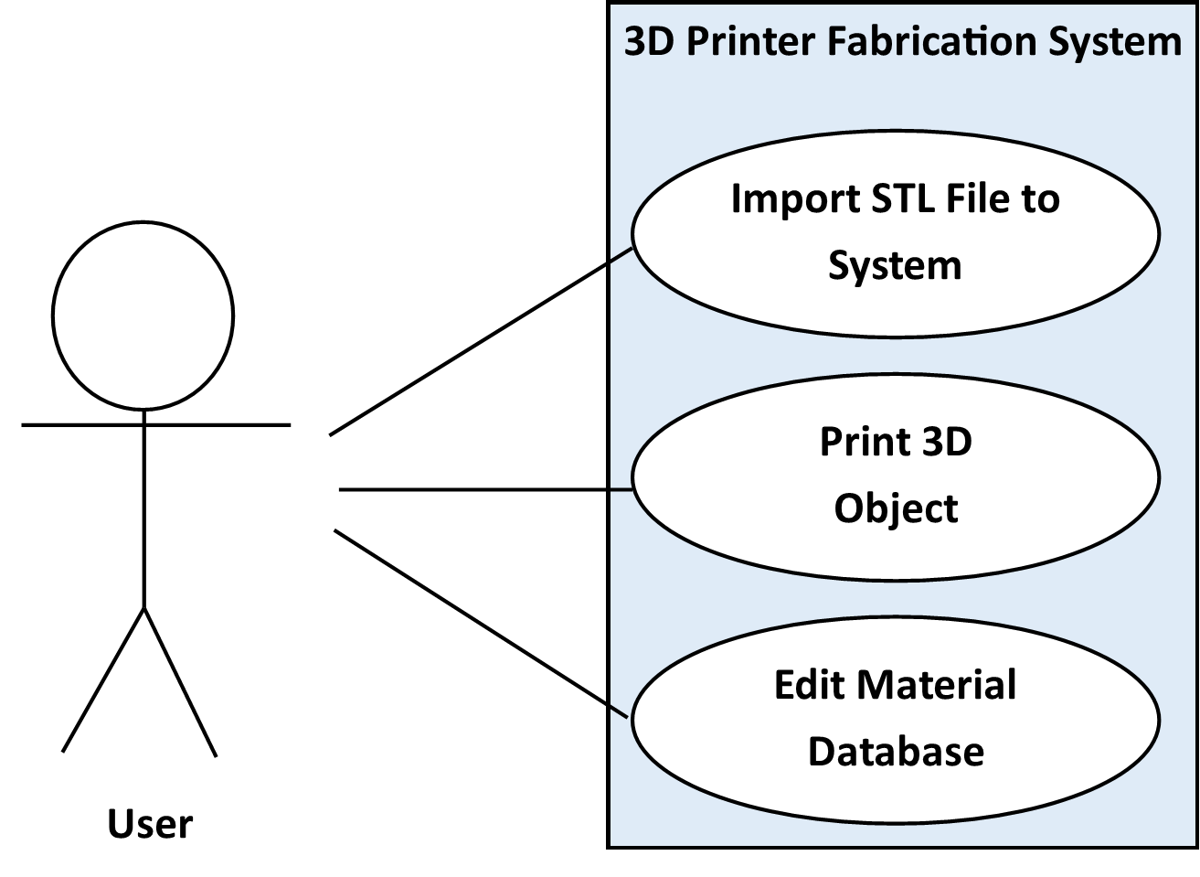
Use Case Diagram

